Slide 1

14-20 AUGUST
CONGRESS CENTRE
ANGERS - FRANCE
www.ihc2022.org

Slide 2

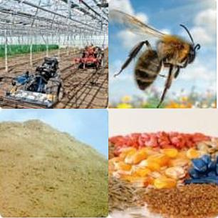
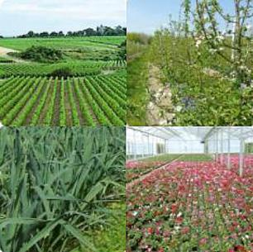
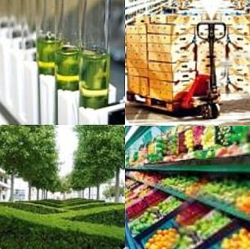


Horticultural sciences:
The specialized plant from upstream to downstream
Upstream
Production
Downstream
seeds
Fruits and vegetables
Transformation
Agricultural equipment
Flowers and plants • vines
Marketing
Agricultural machinery • software
medicinal plants • cider
distribution

Slide 3
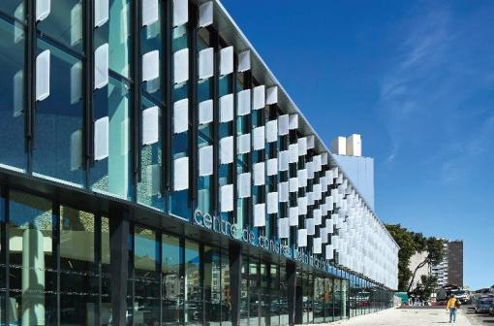
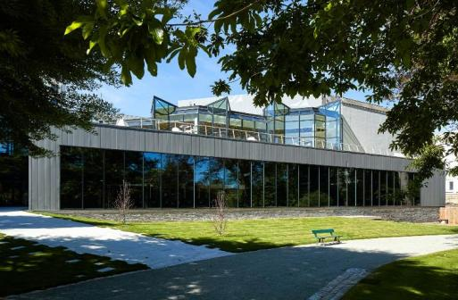
From August 14th to 22 in Angers
At the heart of the city centre:
Congress Centre/University of Angers
Exceptional place bathed in natural light
At the heart of a botanical garden
In the heart of the city 10 mins from train station and hotels

Slide 4
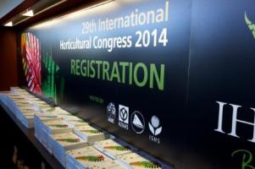

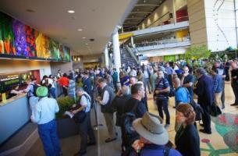
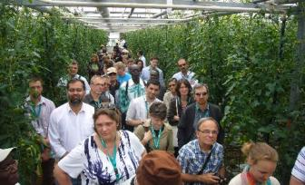
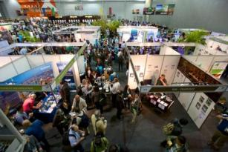
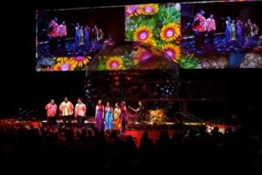
A global event with many facets
6 days of congress
25 Symposia
Networking
4 Plenary sessions
Technical tours
Exhibition
Cultural program

Slide 5
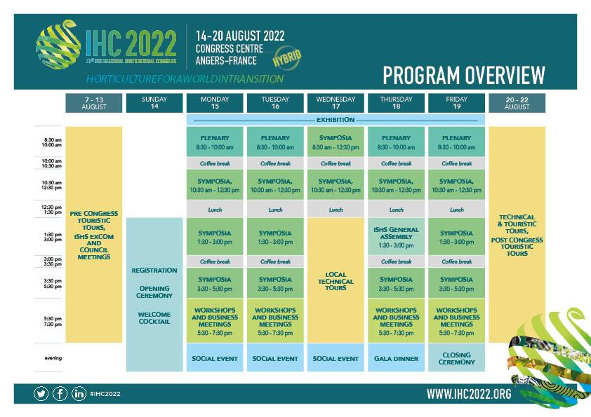
Pré programme

Slide 6
Spirit of the congress
3 major axes
  A high level scientific event
  An event for the meeting of the triptych : Research/Industry/Formation
  An event to facilitate North and South collaborations

Slide 7

Target Audience
  Researchers
  Teacher researchers
  Students
  Professionnals / industriels
  Public authorities
  Specialized media
3 000 delegates 4 000 attendees

Slide 8




Scientific issues
    Competitiveness and skills for the Horticultural sectors
    Food, Public Health & Well-being
    Sustainability of production systems
    Climate change mitigation
    and adaptation solutions

Slide 9

Thank you for your attention
It’s up to you !

Slide 10
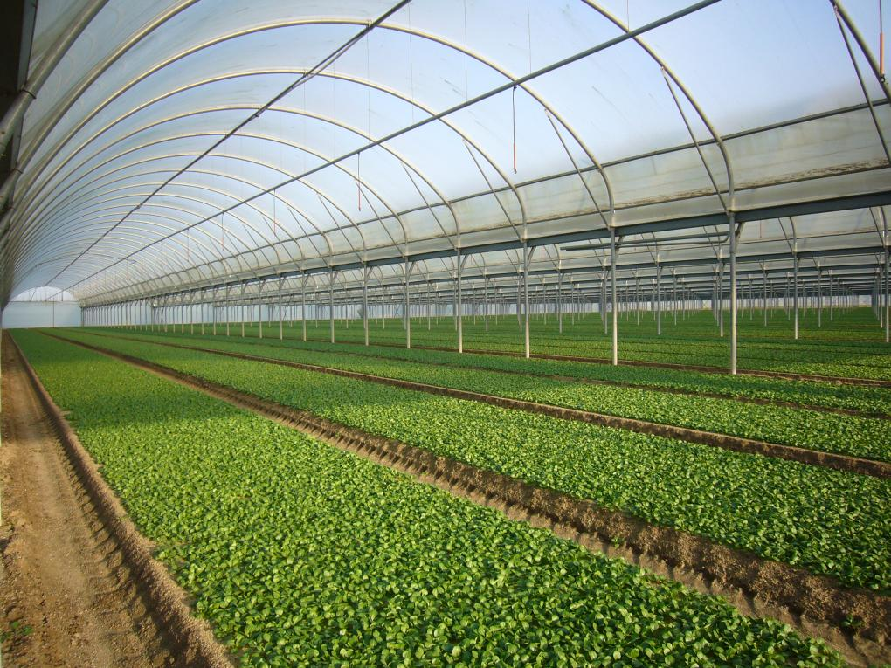



UNDER THE AEGIS OF
14-20 AUGUST
CONGRESS CENTRE
ANGERS - FRANCE
#IHC2022
VEGEPOLYS - Maison du Végétal - 26, rue Jean Dixmeras 49066 Angers Cedex 1
+ 33 (0)2 41 72 17 37
emmanuelle.rousseau@vegepolys.eu

